Slide 1

Eazy Diner Through Web Scrapping and Data Analysis
Project Associates
Shahbaaz Shaik
Mrudhula Pulugu

Slide 2
ABOUT US
Shahbaaz Shaik
Bachelor of Science MSCs Graduate | Data Analytics Skilled in Python | EDA |
LinkedIn: https://in.linkedin.com/in/shahbaaz-shaik-a52764366
GitHub: https://github.com/shahbaaz2803
Mrudhula Pulugu
B.Tech CSE(AI) Graduate | Data Analytics Skilled in Python | EDA |
LinkedIn: https://www.linkedin.com/in/pulugu-mrudhula-3485ba257
GitHub: https://github.com/Mrudhula736

Slide 3
Agenda:
03
Conclusion
Experience/Challenges
02
Exploratory Data Analysis:
Data Cleaning Steps
Data Manipulation Steps
Univariate Analysis Steps
Bivariate Analysis Steps
Multi Variate Analysis steps
Introduction
Business Problem
Objective of the Project
Tools used
Web Scraping – Details (Websites, Processor followed by us)
Summary of the Data
01

Slide 4
Introduction:
Restaurants Data was collected from an online EazyDiner website through Web scraping.
The dataset contains details like Restaurant name, city, area, cuisine type, cost for two and ratings.
The collected raw data was cleaned and organized by removing duplicates and formatting inconsistent values.
Data analysis was performed to understand pricing patterns, customer preferences, and restaurant performance across cities.
Visualizations were created to effectively showcase trends in price versus ratings and cuisine types.
The insights help customers choose restaurants that best match their preferences and assist businesses in refining their pricing and marketing strategies.

Slide 5
Business Problem:
The restaurant industry is rapidly expanding across major Indian cities, leading to high competition and diverse customer choices.
Customers often struggle to identify restaurants that fit their budget, preferred cuisine, and quality expectations.
There is a need to analyze data from platforms like EazyDiner to understand trends in cost, ratings, and cuisine popularity across cities.
Restaurants lack data-driven insights to optimize pricing, improve service quality, and enhance customer satisfaction.
Such analysis can help businesses make informed strategic decisions and help customers choose better dining options based on real insights.

Slide 6
Objectives:
To collect real-time Restaurant data from an online EazyDiner website using web scraping.
To clean and preprocess the collected data for accurate and structured analysis.
To study the relationship between cost for two and ratings.
To determine the most common and popular cuisine types across different areas.
To visualize trends and comparisons using charts for better market understanding.
To compare restaurant performance based on ratings and pricing trends.
To extract insights that help in understanding customer preferences and market positioning.

Slide 7
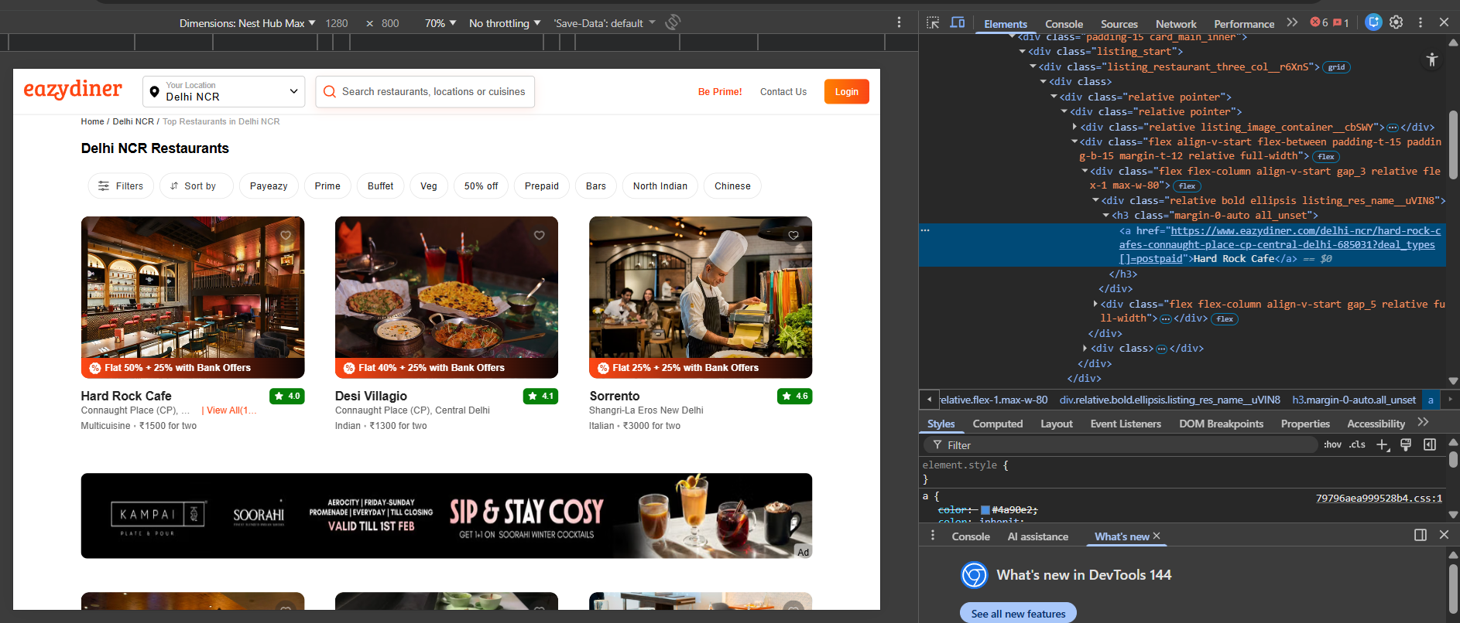
Web Scraping:
Web scraping was used to automatically extract restaurant details from the EazyDiner website.
The dataset was created using Python, leveraging libraries such as Requests and BeautifulSoup to fetch and parse data from multiple city pages.
Key HTML elements such as Restaurant Name, City, Area, Cuisine Type, Cost for Two, and Ratings were identified and extracted from each listing.
The extraction loop was automated to navigate through multiple pages for each city, ensuring the collection of a large and diverse dataset.
Collected data was stored in a structured format (CSV) using Pandas, enabling further cleaning and analysis.
Care was taken to remove advertisements, repeated elements, missing entries, and irrelevant tags during data extraction.
The final output was a clean, structured raw dataset, ready for data preprocessing, transformation, and analysis.
The scraper targeted 31 major cities across India and abroad, including Delhi-NCR,Mumbai,Pune,Goa, Dubai, and others.

Slide 8







Tools Used:

Slide 9
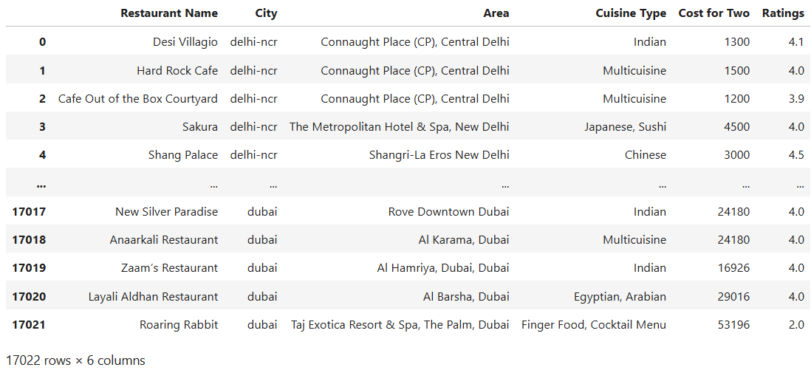
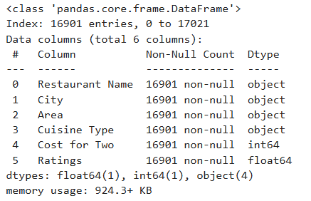
Dataset:

Slide 10
Data Cleaning Steps
Data
Profiling
Data Profiling
Inspect the scraped data from multiple cities to understand its structure.
Check if all columns are properly captured. Identify missing, incomplete, or inconsistent records.
2. Remove Duplicates
Web scraping often extracts the same restaurant more than once, especially across city pages.
Remove duplicate restaurant names or repeated URLs.
Ensure each restaurant entry is unique.
3. Fix Structural Errors
Correct formatting inconsistencies in columns.
Clean extra spaces, symbols, or HTML tags
4. Data Transformation
Convert data into proper types for analysis.
Handling missing values
5. Filter Unwanted Outliers
Identify and handle unrealistic values..
6. Handle Missing Data • Identify columns with null or missing values. • Apply appropriate techniques such as imputation (mean/median/mode) or deletion, depending on data significance.
7. Data Validation • Re-check the cleaned dataset for accuracy, consistency, and completeness. • Validate that all transformations and corrections were successfully applied before moving to analysis.
Data
Validation
Remove
Duplicates
Data
Cleaning
Process
Handle
Missing Data
Fix
Structural
errors
Filter
Unwanted
Outliers
Data
Transformation

Slide 11
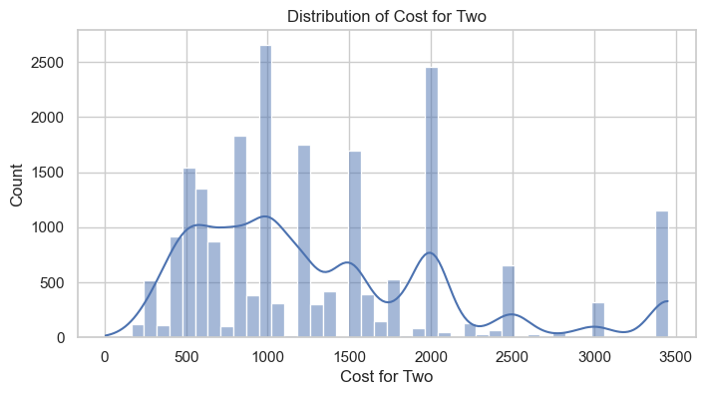
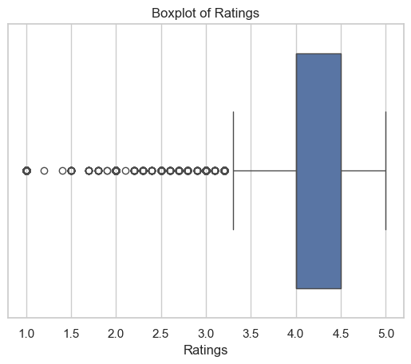
Data Visualizations
Univariate Analysis
Histogram (Cost for Two):
Most restaurants fall in the ₹500 to ₹2000 range, indicating that the majority are mid-range and affordable dining options.
The peak around ₹900–₹1200 suggests this is the most common spending range for customers.
There are fewer restaurants above ₹2500, showing that premium or luxury dining options are limited.
The distribution is slightly right-skewed, meaning a small number of high-cost restaurants increase the overall spread of prices.
Box Plot (Ratings):
The median rating is around 4.2–4.3, showing that most restaurants receive high customer ratings.
The box (IQR) lies mostly between 4.0 and 4.5, indicating that the majority of restaurants are consistently well-rated.
Several outliers appear on the lower side (below 3.5), representing a few poorly rated restaurants.
The concentration of values in the higher range confirms that customer satisfaction is generally strong across the platform.

Slide 12
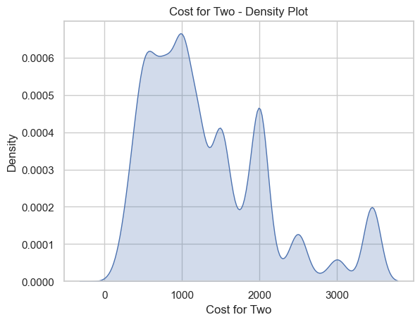
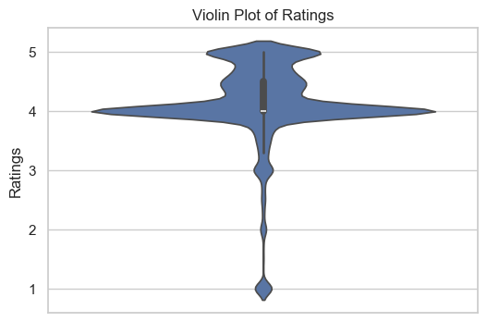
KDE Plot [Cost for Two - Density Plot]
The highest density peak is around ₹800–₹1200, indicating this is the most common spending range for customers.
A noticeable secondary peak appears around ₹1800–₹2000, showing a smaller premium dining segment.
The curve gradually decreases after ₹2500, meaning fewer restaurants fall in the high-cost category.
The overall shape is slightly right-skewed, indicating that a small number of expensive restaurants extend the upper range of prices.
Violin Plot (Ratings):
The widest part of the violin is around 4.0–4.5, indicating that most restaurants have ratings in this range.
The median rating lies slightly above 4.0, showing overall strong customer satisfaction.
The narrow lower portion below 3.0 indicates that very few restaurants have low ratings.
The distribution is concentrated toward the higher end, confirming that most restaurants are well-rated.

Slide 13
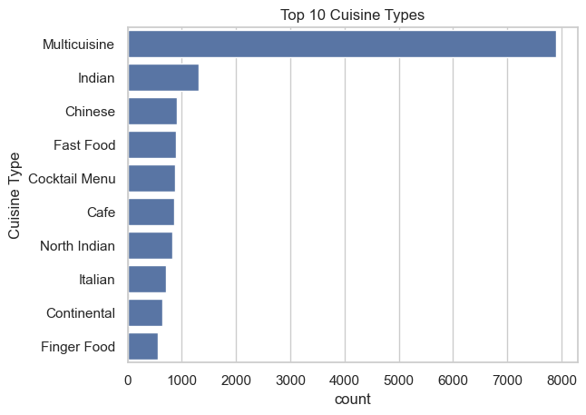
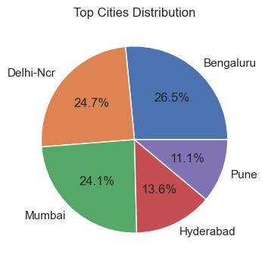
.
Count Plot (Top 10 Cuisine Types):
Multicuisine dominates significantly, indicating that most restaurants offer multiple cuisine options.
Indian cuisine is the second most common, showing strong local food preference.
Chinese, Fast Food, Cafe, and North Indian cuisines also appear frequently, indicating diverse customer choices.
Other cuisines like Italian, Continental, and Finger Food are present but in comparatively smaller numbers.
Pie Chart (City Distribution):
Bengaluru contributes the highest share (~26.5%), indicating it has the largest restaurant presence among top cities.
Delhi-NCR (~24.7%) and Mumbai (~24.1%) follow closely, showing strong competition among major metro cities.
Hyderabad (~13.6%) and Pune (~11.1%) contribute smaller but significant portions.
The chart clearly highlights that the restaurant market is dominated by major metropolitan cities.

Slide 14
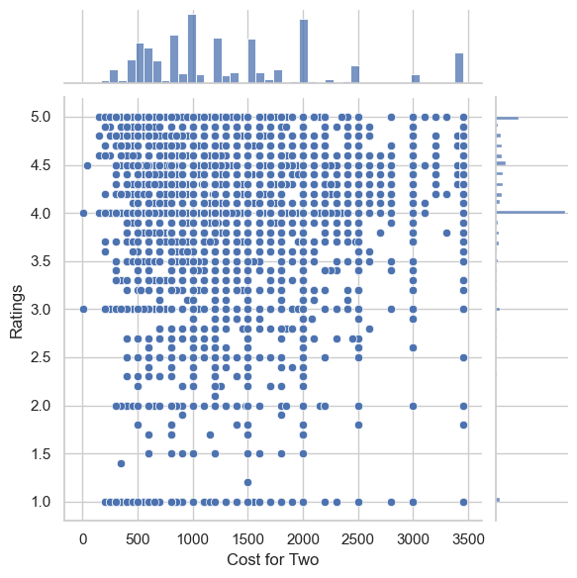
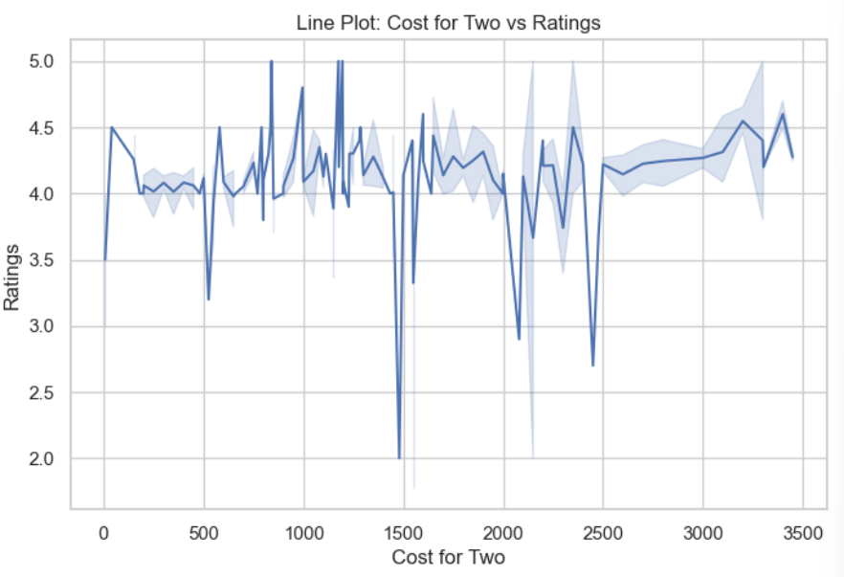
Bivariate Analysis (Numerical - Numerical)
Scatter plot (Cost for Two vs Ratings):
The points are widely scattered, indicating no strong linear relationship between cost and ratings.
High ratings (above 4.0) appear across almost all price ranges, showing that both affordable and expensive restaurants can be well-rated.
Some low-rated restaurants exist at different cost levels, suggesting that higher price does not guarantee better ratings.
Overall, the relationship appears weak or slightly positive, but not strongly correlated.
Line Plot (Cost for Two vs Ratings):
Ratings fluctuate across different cost levels, showing no consistent upward or downward trend.
Most ratings remain around 4.0–4.5, regardless of the cost range.
A few sudden drops in the line represent low-rated restaurants at certain price points.
Overall, the trend suggests that increasing cost does not significantly increase ratings.

Slide 15
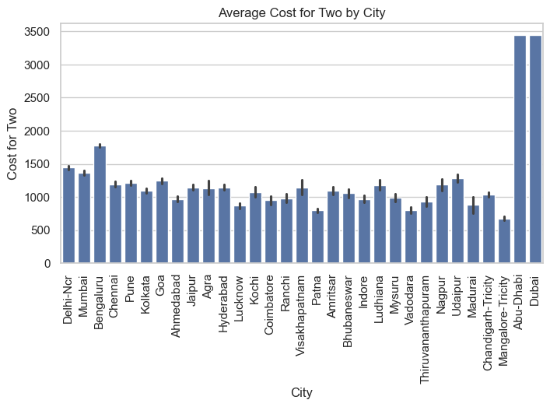
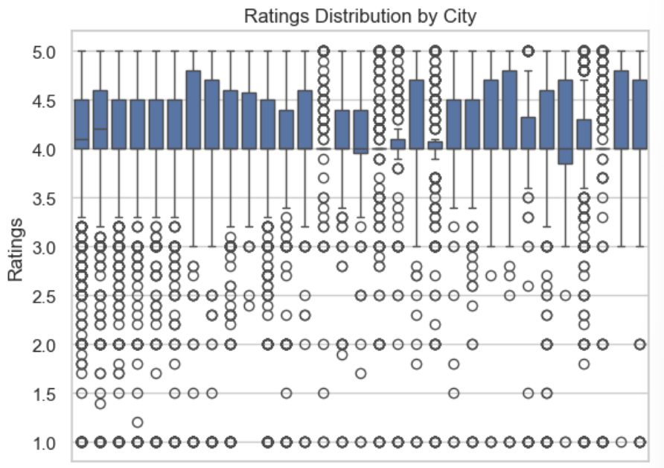
Bivariate Analysis (Numerical - Categorical)
Bar Plot (Average Cost for Two by City):
Dubai and Abu Dhabi show the highest average cost, indicating premium dining markets in these cities.
Among Indian cities, Bengaluru, Mumbai, and Delhi-NCR have relatively higher average costs, reflecting strong metropolitan pricing.
Many tier-2 cities have average costs around ₹800–₹1200, indicating more affordable dining options.
The variation across cities highlights how location significantly influences restaurant pricing.
Box Plot (Ratings by City):
Most cities have median ratings around 4.0 to 4.5, indicating generally high customer satisfaction across locations.
The boxes are relatively compact in many cities, showing consistent ratings with limited variation.
Several lower outliers (below 3.0) appear across cities, representing a few poorly rated restaurants.
No city shows extremely low median ratings, suggesting that restaurant quality is fairly stable across regions.

Slide 16
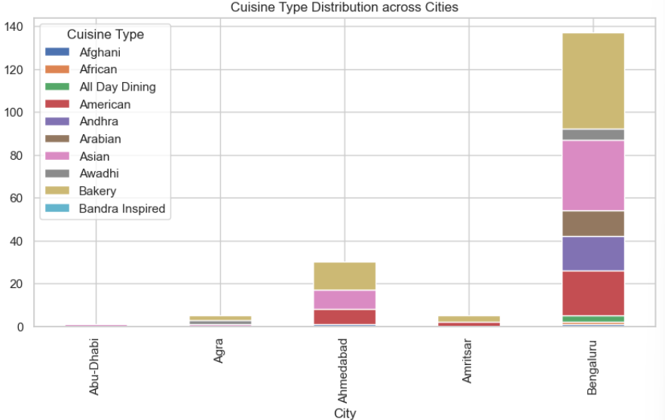
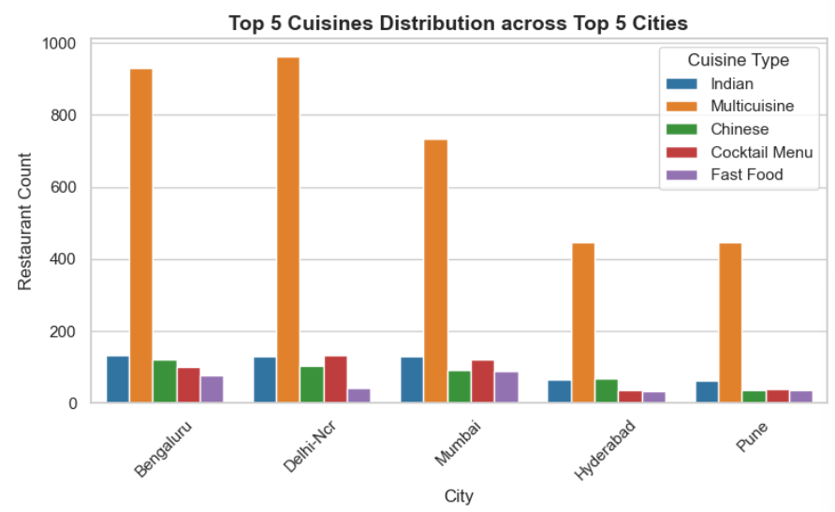
Bivariate Analysis (Categorical - Categorical)
Stacked Bar Plot (Cuisine Type across Cities):
Bengaluru shows the highest overall count of different cuisine types, indicating a diverse food culture.
Ahmedabad also has a noticeable distribution of multiple cuisines, but lower compared to Bengaluru.
Cities like Abu Dhabi, Agra, and Amritsar show limited cuisine variety in comparison.
The stacked structure clearly shows how cuisine diversity varies from city to city, reflecting regional demand and urbanization level.
Count Plot (Top 5 Cuisines across Top 5 Cities):
Multicuisine clearly dominates in all top cities, especially in Delhi-NCR and Bengaluru, showing strong demand for diverse food options.
Indian and Chinese cuisines also have consistent presence across major metro cities.
Mumbai and Delhi-NCR show relatively higher counts across multiple cuisine types, indicating greater food diversity.
Hyderabad and Pune have comparatively lower counts, suggesting a smaller but still active restaurant market.

Slide 17
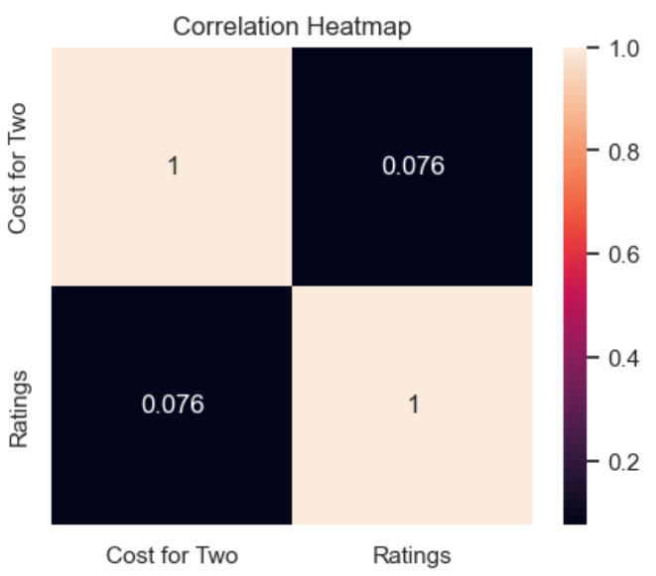
Multivariate Analysis
Heatmap (Correlation Matrix):
The correlation value between Cost for Two and Ratings is 0.074, which is very close to 0.
This indicates a very weak positive relationship between price and ratings.
The value is too small to suggest any meaningful linear relationship.
This confirms that higher restaurant cost does not strongly influence customer ratings.

Slide 18
Conclusion:
The dataset reveals a predominantly mid-range dining market, with most restaurants priced between ₹500–₹1500, catering to budget-conscious customers.
High customer satisfaction is evident, as ratings are concentrated around 4.0–4.5 across cities, indicating consistent service quality and positive dining experiences.
Multicuisine restaurants dominate in all major metros, highlighting strong consumer preference for variety and diverse food options.
Metro cities like Bengaluru, Delhi-NCR, and Mumbai hold the largest share of restaurants, confirming their role as India’s primary food hubs.
Price and rating correlation is negligible (0.07), proving that higher cost does not ensure better ratings — quality, service, and experience matter more.
Overall, the restaurant ecosystem is diverse, competitive, and customer-driven, with affordability and satisfaction at its core.

Slide 19
Experience:
Understood how to collect real-world data from websites using web scraping.
Improved skills in data cleaning, preprocessing, and feature formatting.
Gained experience in using Python libraries for data analysis and visualization.
Learned end to end data workflow : webs craping – cleaning data – analyzing -- visualization.
Enhanced ability to present analytical findings clearly using charts and explanations.

Slide 20
Challenges Faced
Dynamic webpage where data reloads and updates frequently.
Inconsistent HTML structures across product pages.
Missing or incomplete product details during extraction.
Handling duplicate and unclean scraped data.
Handling slow extraction due to dynamic page loading.
Selecting the most relevant visuals for insightful analysis.

Slide 21

THANK YOU

